Slide 1
DL Shop & Checkout Refactoring Concept & User Flow
PT/BDO-BD-RS
Ugljesa Djordjevic
26.02.2024.

Slide 2
User Flow
Step 1 User clicks on the checkout button one the view cart page
Checkout Start
Shipping Info
Payment Info
Summary
Step 2 User adds info for delivery and shipping fee calculation
Step 3 Users adds payment info from which order will be payed
Step 4 Summary of users order
$
Step 5 User reaches the thank you page meaning that order is payed and it entered the system

Slide 3
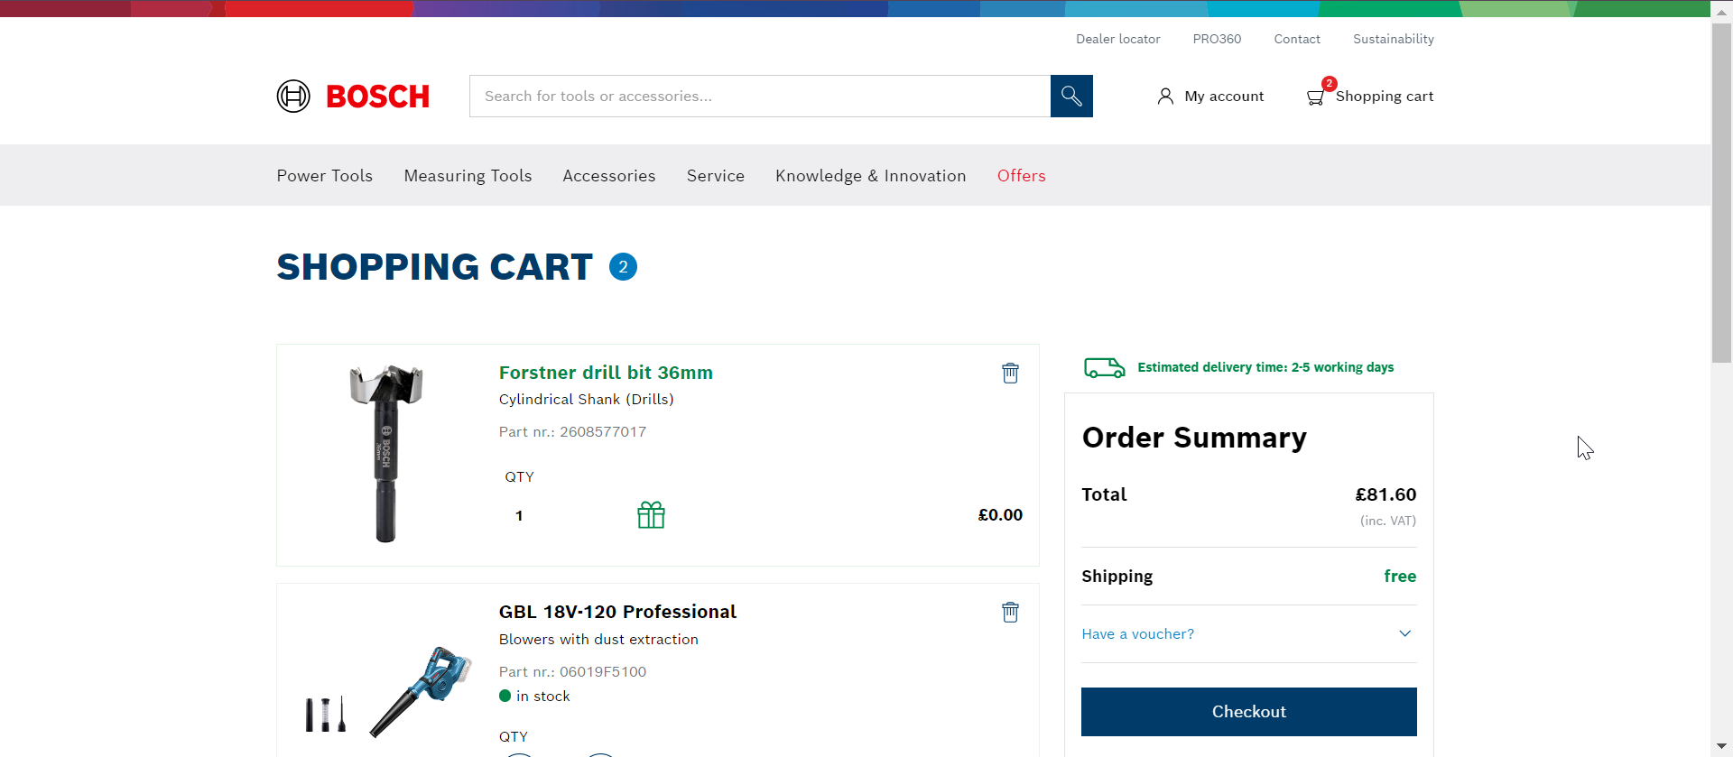
Cart View
PT Data Layer Shop Refactoring – Event Specs
Trigger:
When a cart page is loaded
Deprication of auto page views, script should be implemented on the page:
window.utag_cfg_ovrd = window.utag_cfg_ovrd || {};
window.utag_cfg_ovrd.noview = true
utag.view({
"tealium_event": "PT_ShopCart_Pageload",
"baretool_number": ["ARRAY"],
"brand_name": "STRING",
"business_unit": "STRING",
"currency": "STRING",
"division": "STRING",
"language": "STRING",
"logged_in_user": "STRING",
"master_order_number": ["ARRAY"],
"order_coupon_code": "STRING",
"page_breadcrumb": ["ARRAY"],
"page_country": "STRING",
"page_id": "STRING",
"page_name": "STRING",
"page_subcategory1": "STRING",
"page_subcategory2": "STRING",
"page_subcategory3": "STRING",
"page_subcategory4": "STRING",
"page_subcategory5": "STRING",
"page_type": "STRING",
"product_brand": ["ARRAY"],
"product_category": ["ARRAY"],
"product_category_id": ["ARRAY"],
"product_id": ["ARRAY"],
"product_name": ["ARRAY"],
"product_price": ["ARRAY of stringified Numbers"],
"product_quantity": ["ARRAY of stringified Numbers"],
"release_id": "STRING",
"site_domain_type": "STRING"});
Notes:
Check with Annika if cart should be a checkout step number 1

Slide 4
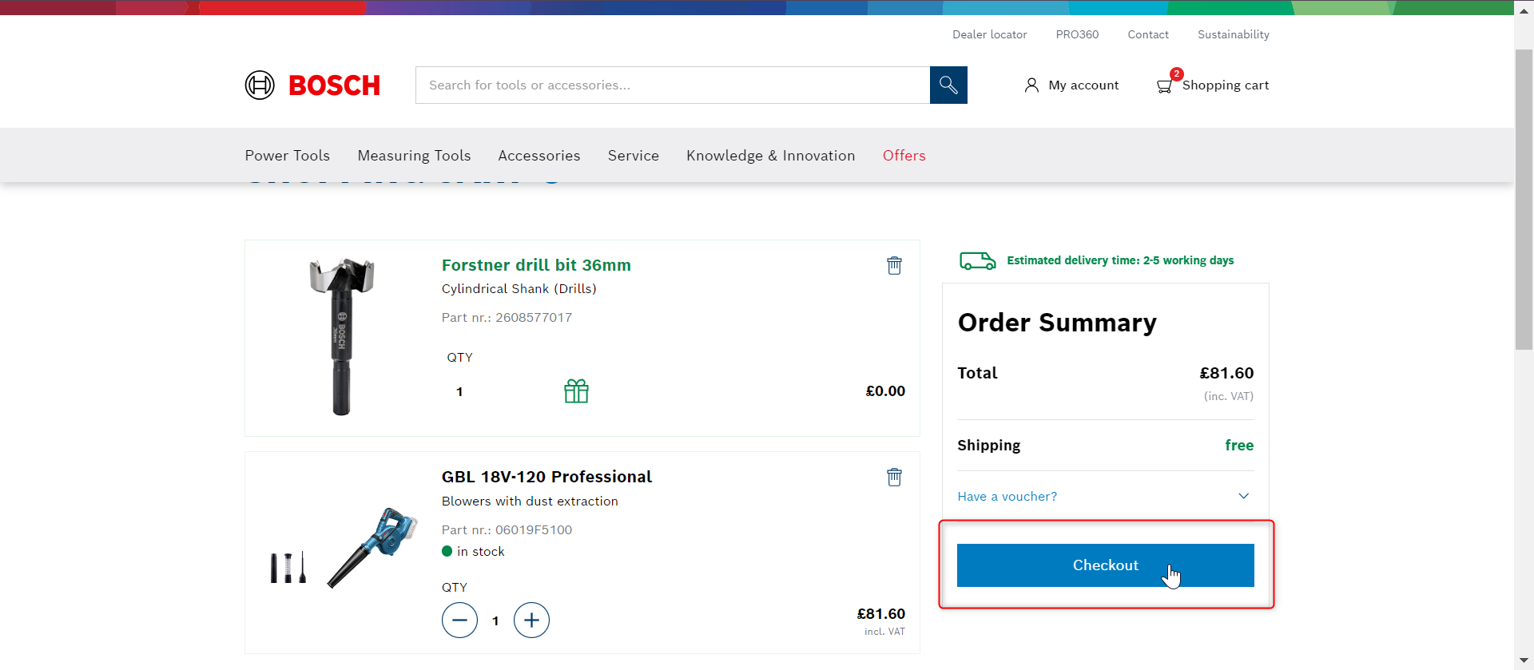
Checkout Start Click
PT Data Layer Checkout Refactoring – Event Specs
Checkout Step 1
Trigger:
When a checkout button is clicked
utag.link({
"tealium_event": "PT_ShopCheckoutStart_Click",
"baretool_number": ["ARRAY"],
"brand_name": "STRING",
"business_unit": "STRING",
"checkout_step": "Stringified NUMBER",
"click_element_class": "STRING",
"click_element_id": "STRING",
"click_name": "STRING",
"click_target_type": "STRING",
"currency": "STRING",
"division": "STRING",
"language": "STRING",
"logged_in_user": "STRING",
"master_order_number": ["ARRAY"],
"order_coupon_code": "STRING",
"page_breadcrumb": ["ARRAY"],
"page_country": "STRING",
"page_id": "STRING",
"page_name": "STRING",
"page_subcategory1": "STRING",
"page_subcategory2": "STRING",
"page_subcategory3": "STRING",
"page_subcategory4": "STRING",
"page_subcategory5": "STRING",
"page_type": "STRING",
"product_brand": ["ARRAY"],
"product_category": ["ARRAY"],
"product_category_id": ["ARRAY"],
"product_id": ["ARRAY"],
"product_name": ["ARRAY"],
"product_price": ["ARRAY of stringified Numbers"],
"product_quantity": ["ARRAY of stringified Numbers"],
"release_id": "STRING",
"site_domain_type": "STRING"});

Slide 5
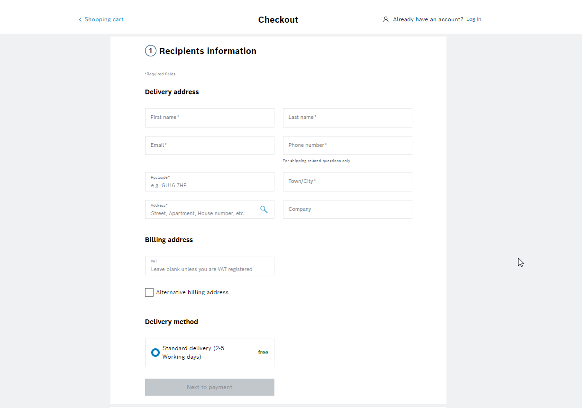
Shiping Info Pageload
PT Data Layer Checkout Refactoring – Event Specs
Checkout Step 2
Trigger:
When a shipping info section is shown
Deprication of auto page views:
window.utag_cfg_ovrd = window.utag_cfg_ovrd || {};
window.utag_cfg_ovrd.noview = true
utag.view({
"tealium_event": "PT_ShopCheckoutShipping_Pageload",
"baretool_number": ["ARRAY"],
"brand_name": "STRING",
"business_unit": "STRING",
"checkout_step": "Stringified NUMBER",
"currency": "STRING",
"division": "STRING",
"language": "STRING",
"logged_in_user": "STRING",
"master_order_number": ["ARRAY"],
"order_coupon_code": "STRING",
"page_breadcrumb": ["ARRAY"],
"page_country": "STRING",
"page_id": "STRING",
"page_name": "STRING",
"page_subcategory1": "STRING",
"page_subcategory2": "STRING",
"page_subcategory3": "STRING",
"page_subcategory4": "STRING",
"page_subcategory5": "STRING",
"page_type": "STRING",
"payment_method": "STRING",
"product_brand": ["ARRAY"],
"product_category": ["ARRAY"],
"product_category_id": ["ARRAY"],
"product_id": ["ARRAY"],
"product_name": ["ARRAY"],
"product_price": ["ARRAY of stringified Numbers"],
"product_quantity": ["ARRAY of stringified Numbers"],
"release_id": "STRING",
"site_domain_type": "STRING"});

Slide 6
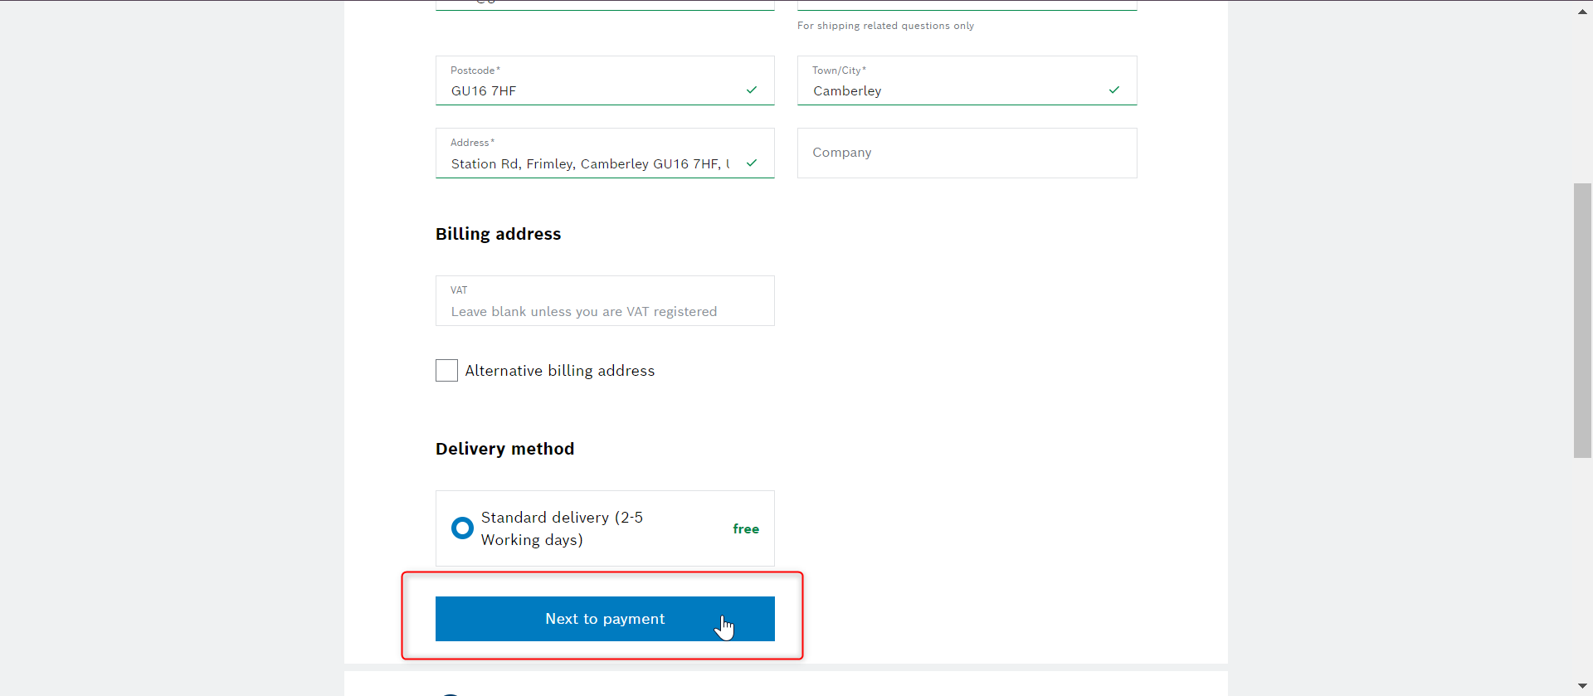
Shipping Info Click
PT Data Layer Checkout Refactoring – Event Specs
Checkout Step 2
utag.link({
"tealium_event": "PT_ShopCheckoutShippingAdded_Click",
"baretool_number": ["ARRAY"],
"brand_name": "STRING",
"business_unit": "STRING",
"checkout_step": "Stringified NUMBER",
"click_element_class": "STRING",
"click_element_id": "STRING",
"click_name": "STRING",
"click_target_type": "STRING",
"currency": "STRING",
"division": "STRING",
"language": "STRING",
"logged_in_user": "STRING",
"master_order_number": ["ARRAY"],
"order_coupon_code": "STRING",
"page_breadcrumb": ["ARRAY"],
"page_country": "STRING",
"page_id": "STRING",
"page_name": "STRING",
"page_subcategory1": "STRING",
"page_subcategory2": "STRING",
"page_subcategory3": "STRING",
"page_subcategory4": "STRING",
"page_subcategory5": "STRING",
"page_type": "STRING",
"payment_method": "STRING",
"product_brand": ["ARRAY"],
"product_category": ["ARRAY"],
"product_category_id": ["ARRAY"],
"product_id": ["ARRAY"],
"product_name": ["ARRAY"],
"product_price": ["ARRAY of stringified Numbers"],
"product_quantity": ["ARRAY of stringified Numbers"],
"release_id": "STRING",
"site_domain_type": "STRING"});
Trigger:
When a „Next to payment“ button is clicked

Slide 7
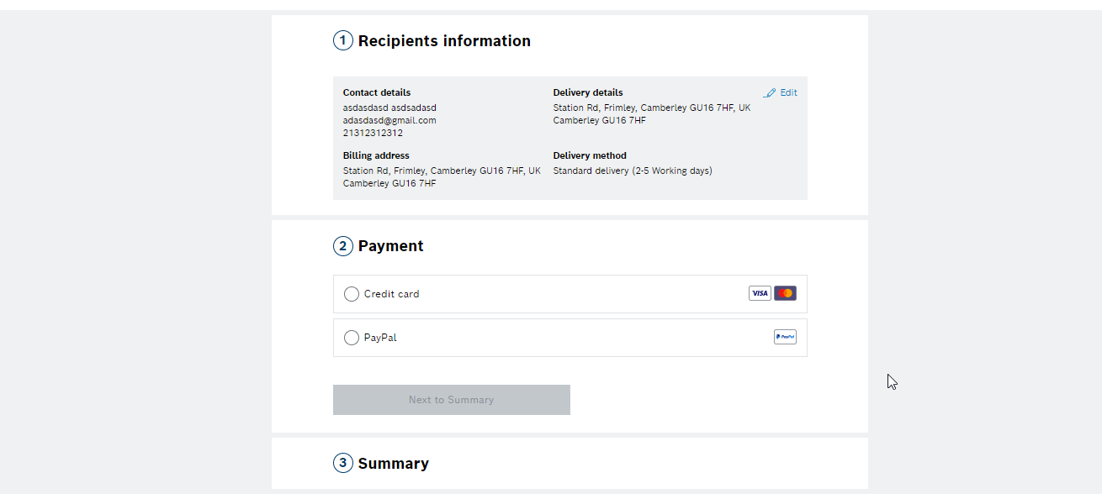
Payment Info Pageload
PT Data Layer Checkout Refactoring – Event Specs
Checkout Step 3
utag.view({
"tealium_event": "PT_ShopCheckoutPayment_Pageload",
"baretool_number": ["ARRAY"],
"brand_name": "STRING",
"business_unit": "STRING",
"checkout_step": "Stringified NUMBER",
"currency": "STRING",
"division": "STRING",
"language": "STRING",
"logged_in_user": "STRING",
"master_order_number": ["ARRAY"],
"order_coupon_code": "STRING",
"page_breadcrumb": ["ARRAY"],
"page_country": "STRING",
"page_id": "STRING",
"page_name": "STRING",
"page_subcategory1": "STRING",
"page_subcategory2": "STRING",
"page_subcategory3": "STRING",
"page_subcategory4": "STRING",
"page_subcategory5": "STRING",
"page_type": "STRING",
"payment_method": "STRING",
"product_brand": ["ARRAY"],
"product_category": ["ARRAY"],
"product_category_id": ["ARRAY"],
"product_id": ["ARRAY"],
"product_name": ["ARRAY"],
"product_price": ["ARRAY of stringified Numbers"],
"product_quantity": ["ARRAY of stringified Numbers"],
"release_id": "STRING",
"site_domain_type": "STRING"});
Trigger:
When a payment section is shown
Deprication of auto page views:
window.utag_cfg_ovrd = window.utag_cfg_ovrd || {};
window.utag_cfg_ovrd.noview = true

Slide 8
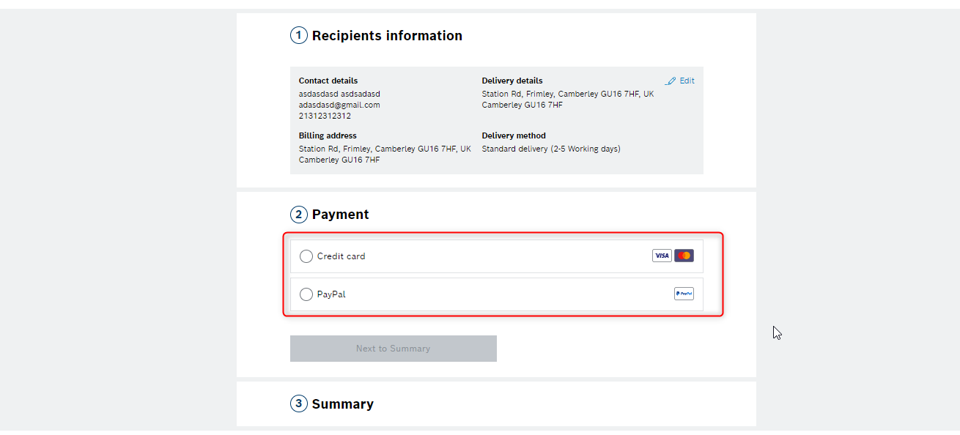
Payment Info Click
PT Data Layer Checkout Refactoring – Event Specs
Checkout Step 3
utag.link({
"tealium_event": "PT_ShopCheckoutPaymentMethod_Click",
"baretool_number": ["ARRAY"],
"brand_name": "STRING",
"business_unit": "STRING",
"checkout_step": "Stringified NUMBER",
"click_element_class": "STRING",
"click_element_id": "STRING",
"click_name": "STRING",
"click_target_type": "STRING",
"currency": "STRING",
"division": "STRING",
"language": "STRING",
"logged_in_user": "STRING",
"master_order_number": ["ARRAY"],
"order_coupon_code": "STRING",
"page_breadcrumb": ["ARRAY"],
"page_country": "STRING",
"page_id": "STRING",
"page_name": "STRING",
"page_subcategory1": "STRING",
"page_subcategory2": "STRING",
"page_subcategory3": "STRING",
"page_subcategory4": "STRING",
"page_subcategory5": "STRING",
"page_type": "STRING",
"payment_method": "STRING",
"product_brand": ["ARRAY"],
"product_category": ["ARRAY"],
"product_category_id": ["ARRAY"],
"product_id": ["ARRAY"],
"product_name": ["ARRAY"],
"product_price": ["ARRAY of stringified Numbers"],
"product_quantity": ["ARRAY of stringified Numbers"],
"release_id": "STRING",
"site_domain_type": "STRING"});
Trigger:
When a Payment method is selected

Slide 9
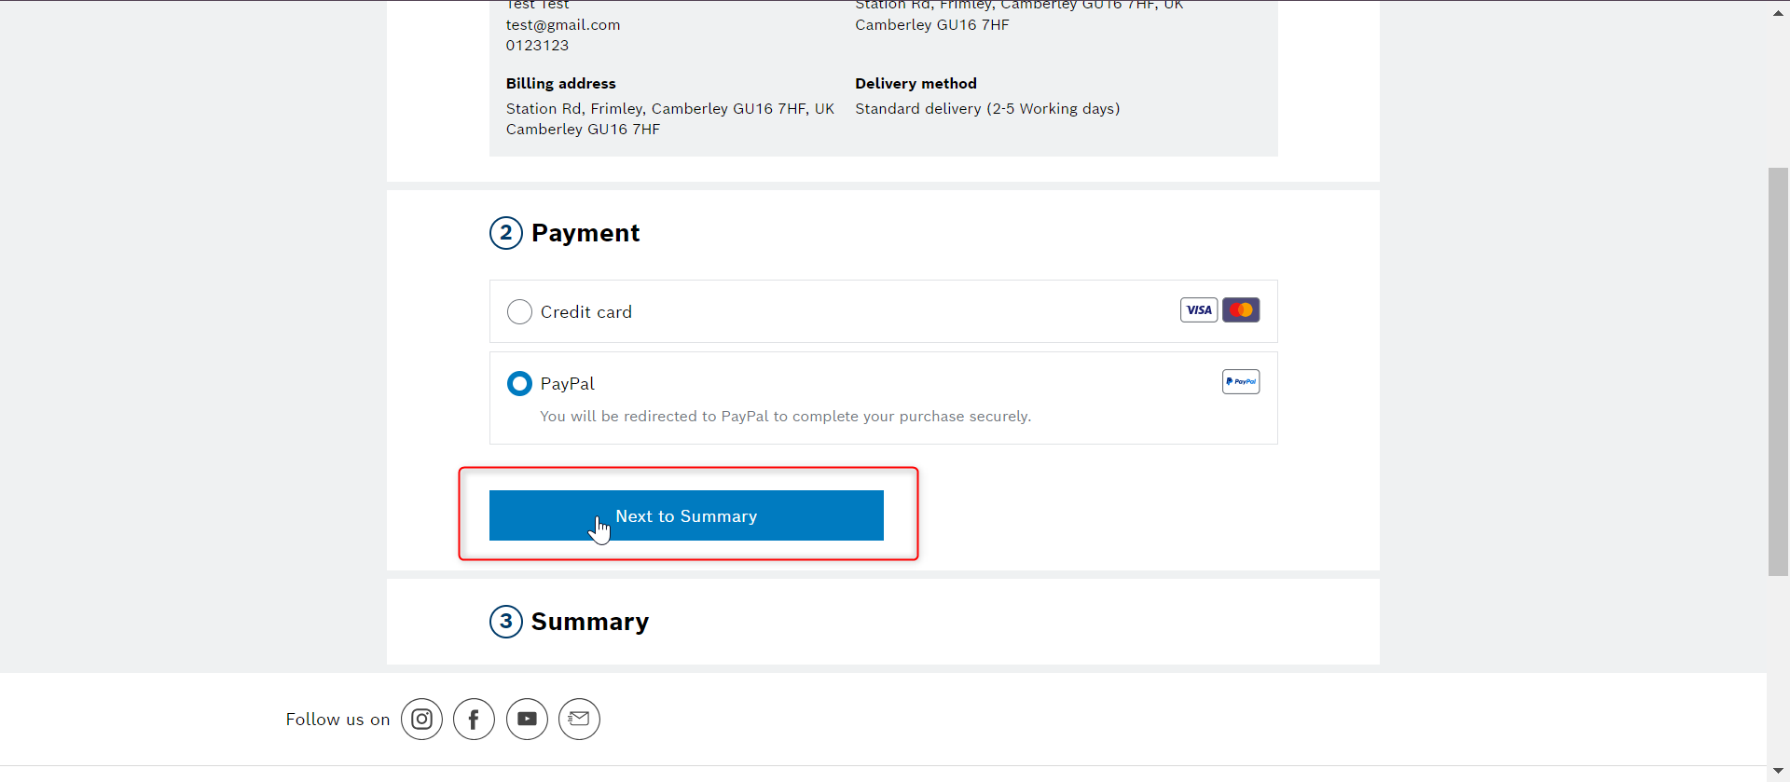
Payment Info Click
PT Data Layer Checkout Refactoring – Event Specs
Checkout Step 3
utag.link({
"tealium_event": "PT_ShopCheckoutPaymentAdded_Click",
"baretool_number": ["ARRAY"],
"brand_name": "STRING",
"business_unit": "STRING",
"checkout_step": "Stringified NUMBER",
"click_element_class": "STRING",
"click_element_id": "STRING",
"click_name": "STRING",
"click_target_type": "STRING",
"currency": "STRING",
"division": "STRING",
"language": "STRING",
"logged_in_user": "STRING",
"master_order_number": ["ARRAY"],
"order_coupon_code": "STRING",
"page_breadcrumb": ["ARRAY"],
"page_country": "STRING",
"page_id": "STRING",
"page_name": "STRING",
"page_subcategory1": "STRING",
"page_subcategory2": "STRING",
"page_subcategory3": "STRING",
"page_subcategory4": "STRING",
"page_subcategory5": "STRING",
"page_type": "STRING",
"payment_method": "STRING",
"product_brand": ["ARRAY"],
"product_category": ["ARRAY"],
"product_category_id": ["ARRAY"],
"product_id": ["ARRAY"],
"product_name": ["ARRAY"],
"product_price": ["ARRAY of stringified Numbers"],
"product_quantity": ["ARRAY of stringified Numbers"],
"release_id": "STRING",
"site_domain_type": "STRING"});
Trigger:
When a „Next to Summary“ button is clicked

Slide 10
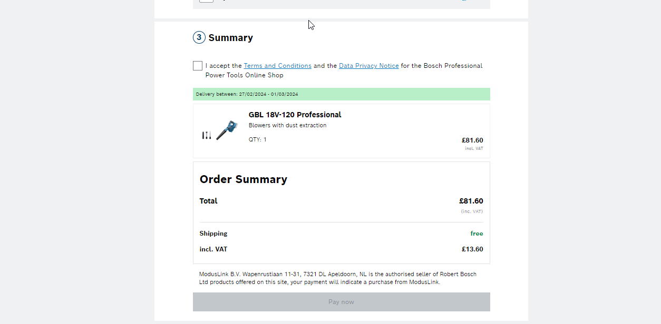
Summary Pageload
PT Data Layer Checkout Refactoring – Event Specs
Checkout Step 4
Trigger:
When a cart page is loaded
Deprication of auto page views:
window.utag_cfg_ovrd = window.utag_cfg_ovrd || {};
window.utag_cfg_ovrd.noview = true
utag.view({
"tealium_event": "PT_ShopCheckoutSummary_Pageload",
"baretool_number": ["ARRAY"],
"brand_name": "STRING",
"business_unit": "STRING",
"checkout_step": "Stringified NUMBER",
"currency": "STRING",
"division": "STRING",
"language": "STRING",
"logged_in_user": "STRING",
"master_order_number": ["ARRAY"],
"order_coupon_code": "STRING",
"page_breadcrumb": ["ARRAY"],
"page_country": "STRING",
"page_id": "STRING",
"page_name": "STRING",
"page_subcategory1": "STRING",
"page_subcategory2": "STRING",
"page_subcategory3": "STRING",
"page_subcategory4": "STRING",
"page_subcategory5": "STRING",
"page_type": "STRING",
"payment_method": "STRING",
"product_brand": ["ARRAY"],
"product_category": ["ARRAY"],
"product_category_id": ["ARRAY"],
"product_id": ["ARRAY"],
"product_name": ["ARRAY"],
"product_price": ["ARRAY of stringified Numbers"],
"product_quantity": ["ARRAY of stringified Numbers"],
"release_id": "STRING",
"site_domain_type": "STRING"});

Slide 11
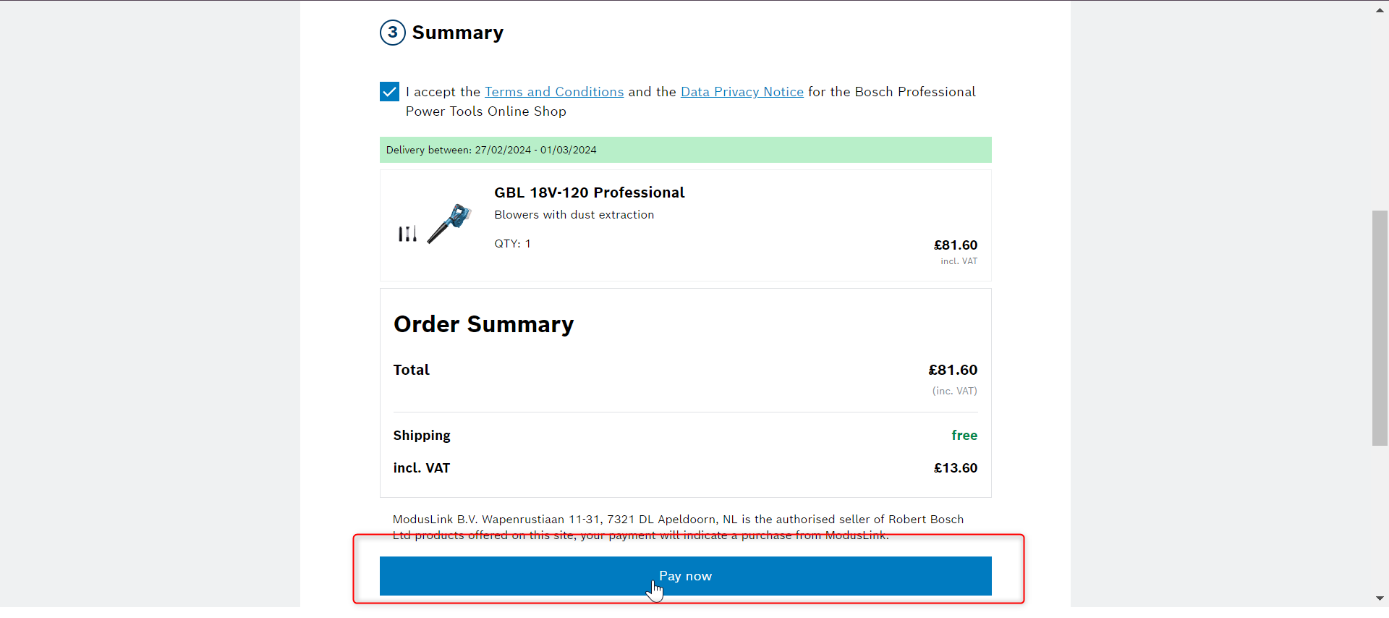
Summary Pay Now Click
PT Data Layer Checkout Refactoring – Event Specs
Checkout Step 4
utag.link({
"tealium_event": "PT_ShopCheckoutSummaryPayNow_Click",
"baretool_number": ["ARRAY"],
"brand_name": "STRING",
"business_unit": "STRING",
"checkout_step": "Stringified NUMBER",
"click_element_class": "STRING",
"click_element_id": "STRING",
"click_name": "STRING",
"click_target_type": "STRING",
"currency": "STRING",
"division": "STRING",
"language": "STRING",
"logged_in_user": "STRING",
"master_order_number": ["ARRAY"],
"order_coupon_code": "STRING",
"page_breadcrumb": ["ARRAY"],
"page_country": "STRING",
"page_id": "STRING",
"page_name": "STRING",
"page_subcategory1": "STRING",
"page_subcategory2": "STRING",
"page_subcategory3": "STRING",
"page_subcategory4": "STRING",
"page_subcategory5": "STRING",
"page_type": "STRING",
"payment_method": "STRING",
"product_brand": ["ARRAY"],
"product_category": ["ARRAY"],
"product_category_id": ["ARRAY"],
"product_id": ["ARRAY"],
"product_name": ["ARRAY"],
"product_price": ["ARRAY of stringified Numbers"],
"product_quantity": ["ARRAY of stringified Numbers"],
"release_id": "STRING",
"site_domain_type": "STRING"});
Trigger:
When a „Pay now“ button is clicked

Slide 12
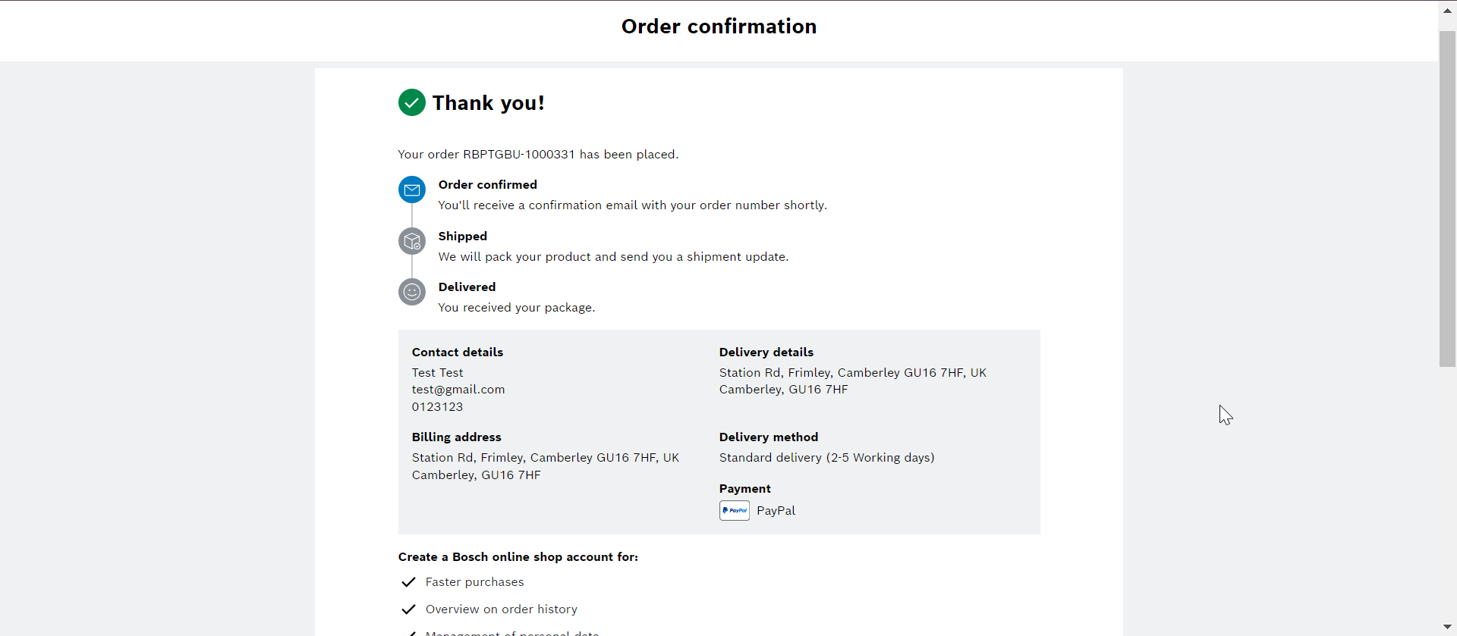
Payment / Thank you page
PT Data Layer Checkout Refactoring – Event Specs
Checkout Step 5
utag.view({
"tealium_event": "PT_ShopOrderConfirmation_Pageload",
"baretool_number": ["ARRAY"],
"brand_name": "STRING",
"business_unit": "STRING",
"checkout_step": "Stringified NUMBER",
"currency": "STRING",
"division": "STRING",
"language": "STRING",
"logged_in_user": "STRING",
"master_order_number": ["ARRAY"],
"order_grand_total": "Stringified NUMBER",
"order_id": "STRING",
"order_shipping_amount": "Stringified NUMBER",
"order_coupon_code": "STRING",
"page_breadcrumb": ["ARRAY"],
"page_country": "STRING",
"page_id": "STRING",
"page_name": "STRING",
"page_subcategory1": "STRING",
"page_subcategory2": "STRING",
"page_subcategory3": "STRING",
"page_subcategory4": "STRING",
"page_subcategory5": "STRING",
"page_type": "STRING",
"payment_method": "STRING",
"product_brand": ["ARRAY"],
"product_category": ["ARRAY"],
"product_category_id": ["ARRAY"],
"product_id": ["ARRAY"],
"product_name": ["ARRAY"],
"product_price": ["ARRAY of stringified Numbers"],
"product_quantity": ["ARRAY of stringified Numbers"],
"release_id": "STRING",
"site_domain_type": "STRING"});
Trigger:
When a thank you page is loaded
Deprication of auto page views:
window.utag_cfg_ovrd = window.utag_cfg_ovrd || {};
window.utag_cfg_ovrd.noview = true

Slide 13

THANK YOU ! 😊

